Slide 1

Mutual Fund Flows and Performance in Rational Markets
Authored by Jonathan B. Berk and Richard C. Green
Presented by Irene Wang

Slide 2
Contents
Research Background
Model Interpretation
Conclusion
My Opinion

Slide 3
Research Background
Issue:
There is little evidence that mutual fund managers outperform passive benchmarks.
The performance of mutual fund managers appears to be largely unpredictable and inconsistent.
Aim:
Construct a rational model for the relationship of fund flows and performance.

Slide 4
Research Background
The model is based on four elements:
There is competitive provision of capital by investors to mutual funds.
There is differential ability to generate high average returns across managers but decreasing returns to scale in deploying these abilities.
There is learning about managerial ability from past returns.
There is no moral hazard or asymmetric information.

Slide 5

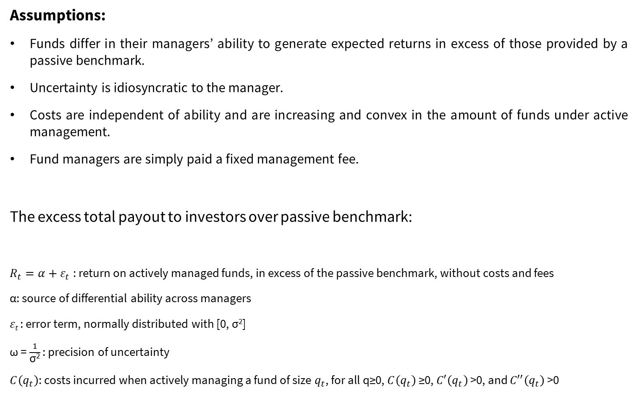
Model Interpretation - Significant parameters
Assumptions:
Funds differ in their managers’ ability to generate expected returns in excess of those provided by a passive benchmark.
Uncertainty is idiosyncratic to the manager.
Costs are independent of ability and are increasing and convex in the amount of funds under active management.
Fund managers are simply paid a fixed management fee.
The excess total payout to investors over passive benchmark:
$R_{t}=α+ε_{t}$: return on actively managed funds, in excess of the passive benchmark, without costs and fees
α: source of differential ability across managers
𝜀_{𝑡} : error term, normally distributed with [0, σ²]
ω = $\frac{1}{\text{σ}\text{2}}$ : precision of uncertainty
$C\left(q_{t}\right)$: costs incurred when actively managing a fund of size $q_{t}$, for all q≥0, $C\left(q_{t}\right)$ ≥0, $C′\left(q_{t}\right)$ >0, and $C′′\left(q_{t}\right)$ >0
Notes:
People learn about manager’s ability by observing the history of portfolio’s returns. This learning is the source of the relationship between performance and the flow of funds.
Uncertainty is idiosyncratic to the manager: by investing with a large number of these managers, investors can diversify away this risk.

Slide 6
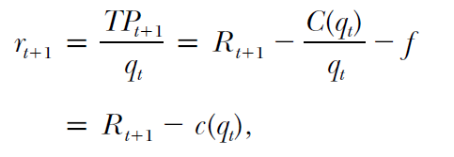


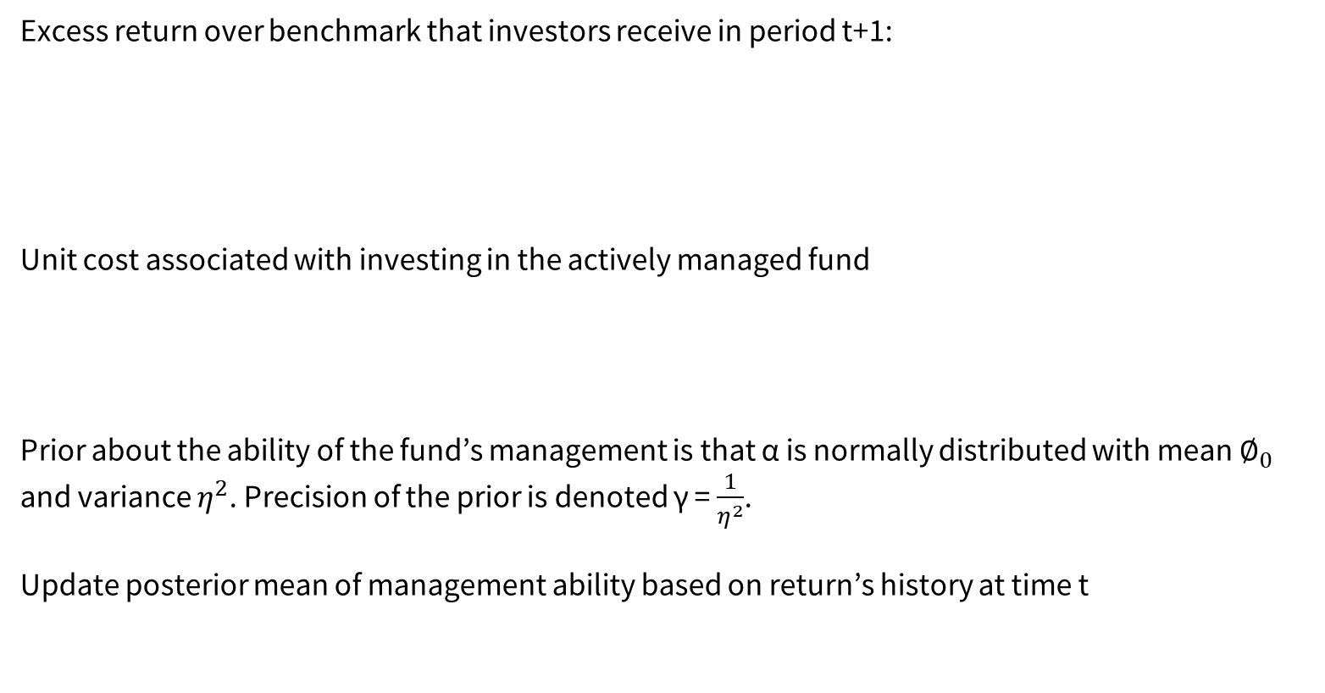
Model Interpretation - Significant parameters
Excess return over benchmark that investors receive in period t+1:
Unit cost associated with investing in the actively managed fund
Prior about the ability of the fund’s management is that α is normally distributed with mean $∅_{0}$ and variance $η^{2}$. Precision of the prior is denoted γ = $\frac{1}{η^{2}}$.
Update posterior mean of management ability based on return’s history at time t
Notes:
Assume costs are independent of ability and are increasing and convex in the amount of funds under active management. These costs refer to transaction costs, not manager’s compensation. Denote the costs incurred when actively managing a fund of size qt as C(qt), for all q≥0, 𝐶(q𝑡 ) ≥0, 𝐶′(𝑞𝑡 ) >0, and 𝐶′′(𝑞𝑡 ) >0.
Assume the fund managers are simply paid a fixed management fee, f, expressed as a fraction of the assets under management.
The fund enters period t with q_{t-1} funds under management and an estimate of managerial ability φ_{t-1}. Managers and investors observe r_{t} (from which they can infer R_{t}) and update estimate of the manager’s ability by calculating φ_{t}. Then capital flows into or out of the fund to determine q_{t}

Slide 7
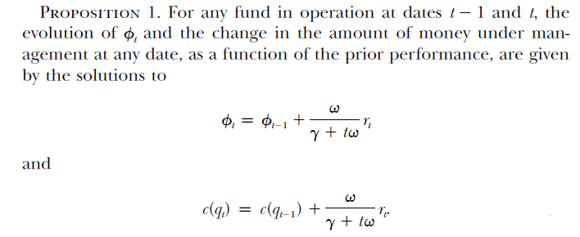
Model Interpretation – Analysis of funds flow and performance
Funds flow to and from each fund so that the expected excess return to investing in any surviving fund is zero.
Implications：
Good performance results in an inflow of funds.
Flows to younger funds respond much more dramatically to performance than flows to more mature funds.
Notes:
Investors supply capital to funds that have positive excess expected returns and remove capital from any fund that has a negative excess expected return. Since all investors in open-ended mutual funds earn the same return, all investors earn zero expected excess return in equilibrium.

Slide 8
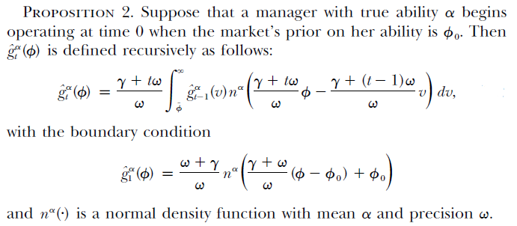

Model Interpretation – Analysis of cross-sectional distribution of funds
As long as φ_{t} is greater than or equal to $\overline{φ}$, the fund survives through period t.
$G_{t}\left(φ\right)$: conditional probability on the fund’s survival though period t
$g_{t}\left(φ\right)=\frac{dG_{t}\left(φ\right)}{dφ}$ : associated density
${\hat{G}}_{t}\left(φ\right)$: joint probability that a fund survives through period t and has φ_{t} ≤ φ
${\hat{G}}_{t}^{α}\left(φ\right)$: joint probability that a fund survives through period t and has φ_{t} ≤ φ, conditional on manager talent α
Notes:
All funds start with the same expectation of managerial ability, φ₀.

Slide 9
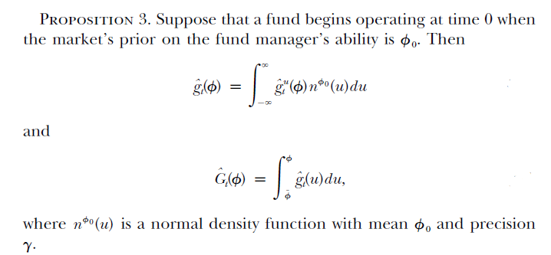
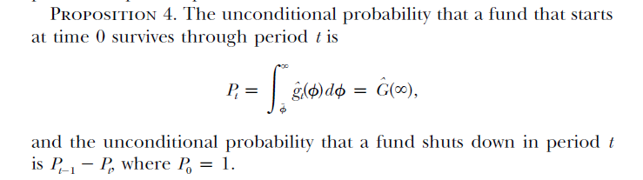
Model Interpretation – Analysis of cross-sectional distribution of funds
Notes:
These explicit expressions can be used to analytically describe the cross-sectional relation between past performance and fund flows.

Slide 10
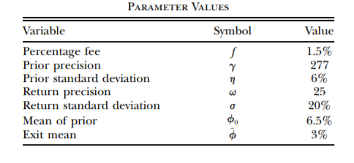
Model Interpretation – Empirical comparison
Select value for parameters based on existing evidence in literature.
Notes:
The authors compare the theoretical flow-performance relation they derived based on the previous expressions to empirical findings in literature

Slide 11
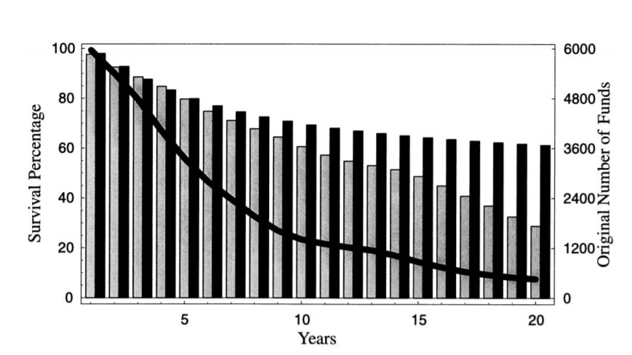
Model Interpretation – Empirical comparison
Light bars are the actual survival rates computed from the CRSP mutual fund database.
Dark bars are what the model predicts the survival rates should be.
Line marks the total number of funds that could have survived at each age.
Notes:
The early data are estimated much more precisely.

Slide 12
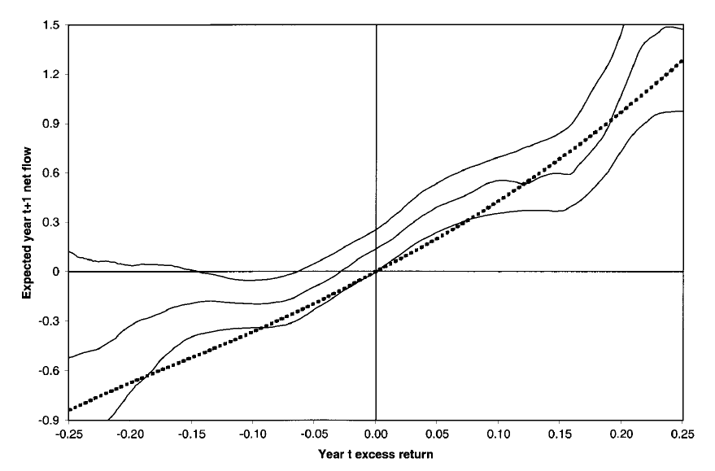
Model Interpretation – Empirical comparison
The dashed line shows the flow of funds for two-year-old funds produced by the model.
The solid lines represent nonparametric estimates and 90 percent confidence intervals.
Notes:
The empirical curve does not go through the origin, as it does in their model. It might due to the general growth in the mutual fund sector during sample period, which is missing in their model.

Slide 13
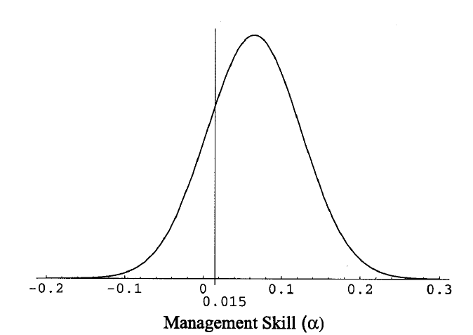
Model Interpretation – Empirical comparison
The prior distribution over management ability using their parameter values.
Notes:
It shows the level of the management fee (1.5 percent). If level of skill in the economy is defined as the fraction of managers who can generate an α in excess of the fees they charge, then this fraction lies on the right of the line. About 80 percent of managers satisfy this criterion.

Slide 14
Conclusion
Derive empirical expressions of a rational model for active portfolio management
Reproduce the salient features of the empirical evidence as equilibrium outcomes in a rational model
Fund flows rationally respond to past performance in the model
The flow-performance relationship is consistent with high average levels of skills

Slide 15
My opinion
Interesting topic
Detailed analysis of assumptions’ validation
Explicit expressions
Inconsistences with empirical evidences
Little analysis on why phenomenon happen
Focus more on the derivations of model rather than explanations
Contribution
Limitation

Slide 16
Question？

